Slide 1



CRIME ANALYSIS
POWER BI DASHBOARD
SRI HARIMA B N
01

Slide 2

PROBLEM STATEMENT :
To enhance public safety and improve the efficiency of law enforcement efforts, this analysis aims to identify and understand the underlying patterns and trends in criminal activities. By examining dimensions such as total crime counts, resolution rates, temporal and geographical distribution, and specific crime types, the objective is to uncover critical insights that can inform effective crime prevention strategies and resource allocation for resolution efforts..
02

Slide 3
OBJECTIVE :
Analyze Crime Statistics
Evaluate and interpret crime data from different countries.
Visualize Crime Trends
Create visual representations of crime trends over time, including yearly, monthly, and weekly patterns.
Examine Crime Distribution
Identify regions with higher crime concentrations and understand regional crime patterns.
Enable Informed Decision-Making
Support policymakers in developing effective crime prevention and resolution policies.
s.
3

Slide 4
METHODOLOGY :
Data Integration: Extract and integrate data from various sources into Power BI.
Aggregated and cleaned crime data from reliable sources to ensure accuracy and reliability.
01
02
Data collection and Data cleaning
03
EDA Findings:Summarize the key insights gained from the crime data analysis, highlighting significant patterns, trends, or unusual data points observed.
Data collection and Data cleaning: Identify key metrics and design visually appealing dashboards to effectively present crime data and insights.
04
05
Interactivity: Implement interactive features for drill down analysis
04

Slide 5

DATA:
Crime ID: Unique identifier for each criminal cases
Crime date: Date of the crime happened
Crime time: Most dangerous crime time
Country: France, Italy, Spain, Denmark, Sweden, Belgium, etc..
Resolved: Number of crimes that are actually
resolved
Crime type: Different types of crimes
happened across different countries
Date Data:
Different dates reveal variations in crime
occurrences across different countries.
05

Slide 6

DASHBOARD TASKS :
1. Total Crimes: Sum of all reported crimes in the dataset.
2. Crime Distribution by Year and Yearly Changes: Analysis of crimes categorized by year, including insights into the year-over-year changes.
3. Crimes by Time Range:Exploration of crime occurrences within specific time intervals, providing a detailed breakdown.
4. Heatmap Showing Crime Distribution by Weekdays and Months:Visualization using a heatmap to illustrate how crimes are distributed across weekdays and months.
5. Crimes by Country: Examination of crimes categorized by the country where they occurred.
06

Slide 7
6. Total Resolved and Unresolved Crimes:
Distinction between resolved and unresolved crimes, offering an overview of the overall resolution rate.
7. Monthly Crime Trend with Percentage Variance:
Analysis of the monthly crime trend, accompanied by the percentage variance to highlight fluctuations.
8. Identification of the Most Dangerous Time of the Day:
Exploration to pinpoint the specific time periods during the day associated with a higher frequency of crimes.
07

Slide 8
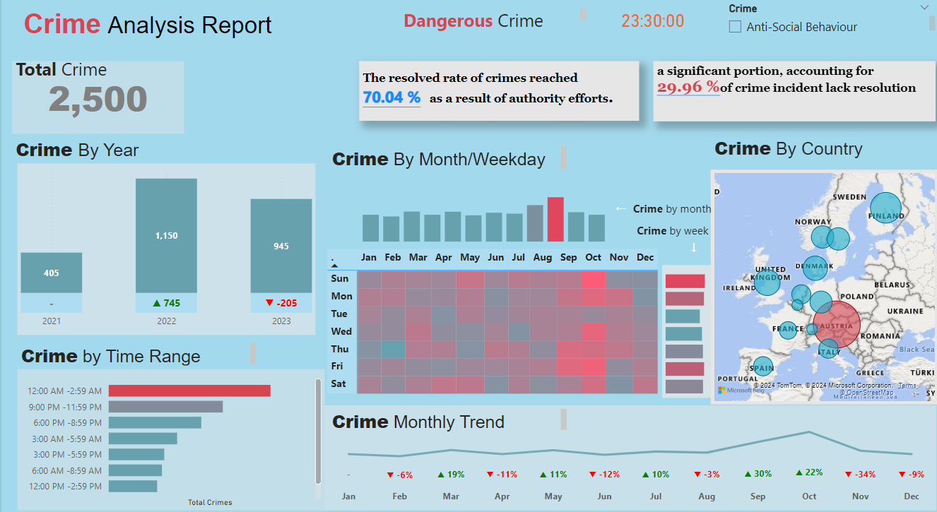
08

Slide 9
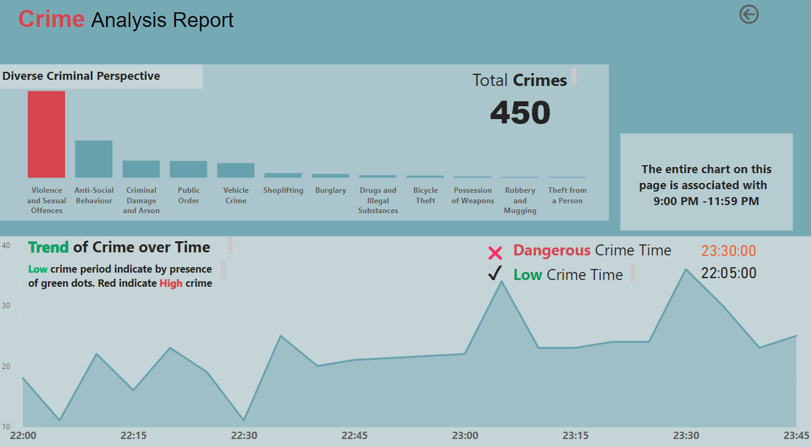
09

Slide 10
Conclusion
Based on the analysis of the crime data, it is evident that 2022 witnessed a significant rise in crime rates, with the peak time for criminal activities occurring between 12:00 AM and 2:59 AM. October emerged as the month with the highest crime incidents, and Austria reported the highest levels of crime, particularly in violent and sexual offenses
These patterns highlight critical areas for intervention, suggesting the need for increased law enforcement presence during late night hours, especially in October, and targeted measures to address violent and sexual crimes in Austria. Enhanced surveillance and community engagement initiatives could also be effective in mitigating these issues.
10

Slide 11
THANK YOU

